Slide 1
Examining the Information Content of Voltage-Dependent, Two-Dimensional Conductance Histograms
Or something like that

Slide 2
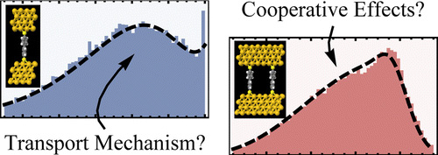
Introduction
Conductance histograms are a common way for experimental studies to characterize the conductance of nanometer-scale systems.
Conductance is measured by running a current through a molecule with two contact points at two electrodes.
Experiments are usually performed with zero bias.
Since experimental techniques are unable to precisely determine the system being measured, the experiment is performed thousands of times in order to generate statistics that can be plotted for a better picture.
Peaks in the graph are traditionally interpreted as the “expected” conductance.

Slide 3
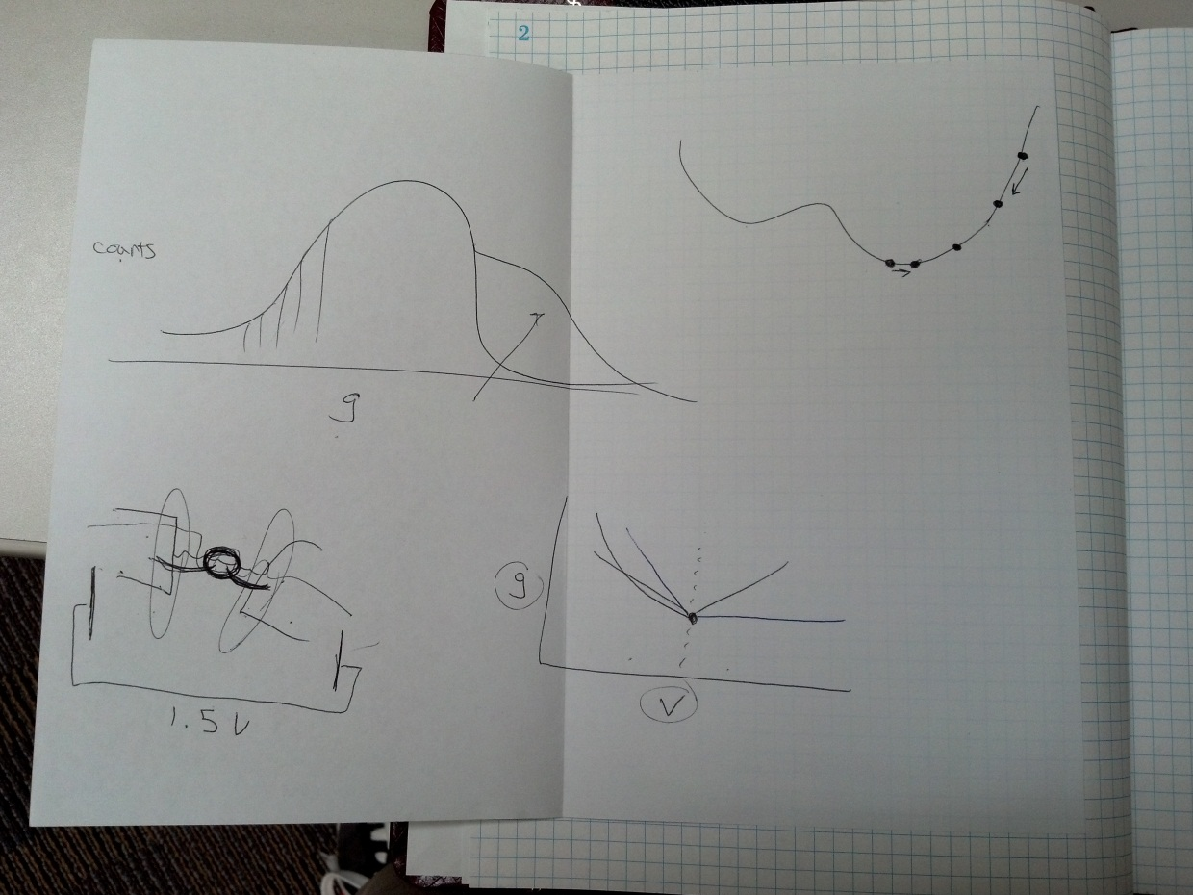
Voltage-Dependent Electron Transport
Landauer-Buttiker-Imry coherent scattering theory for electron transport assumed for transmission calculations. The transmission function:
This equation is too hard to display just write it.

Slide 4
Simulating Conductance Data
Modifying a simple one-dimensional conductance data simulator and a histogram binner written by M. G. Reuter and P. D. Williams…

Slide 5
THE SIMULATORS
Progression:
Original simulator - delivers a list of normally distributed conductances with given specifications of:
model, number of trials, Fermi level, standard deviation of site energy level, site energy level, standard deviation of coupling, coupling for one electrode, coupling for other electrode

Slide 6
V-1d
V-2d
V-2d-rng
V-2d-rng-betad
And a new binner later…

Slide 7
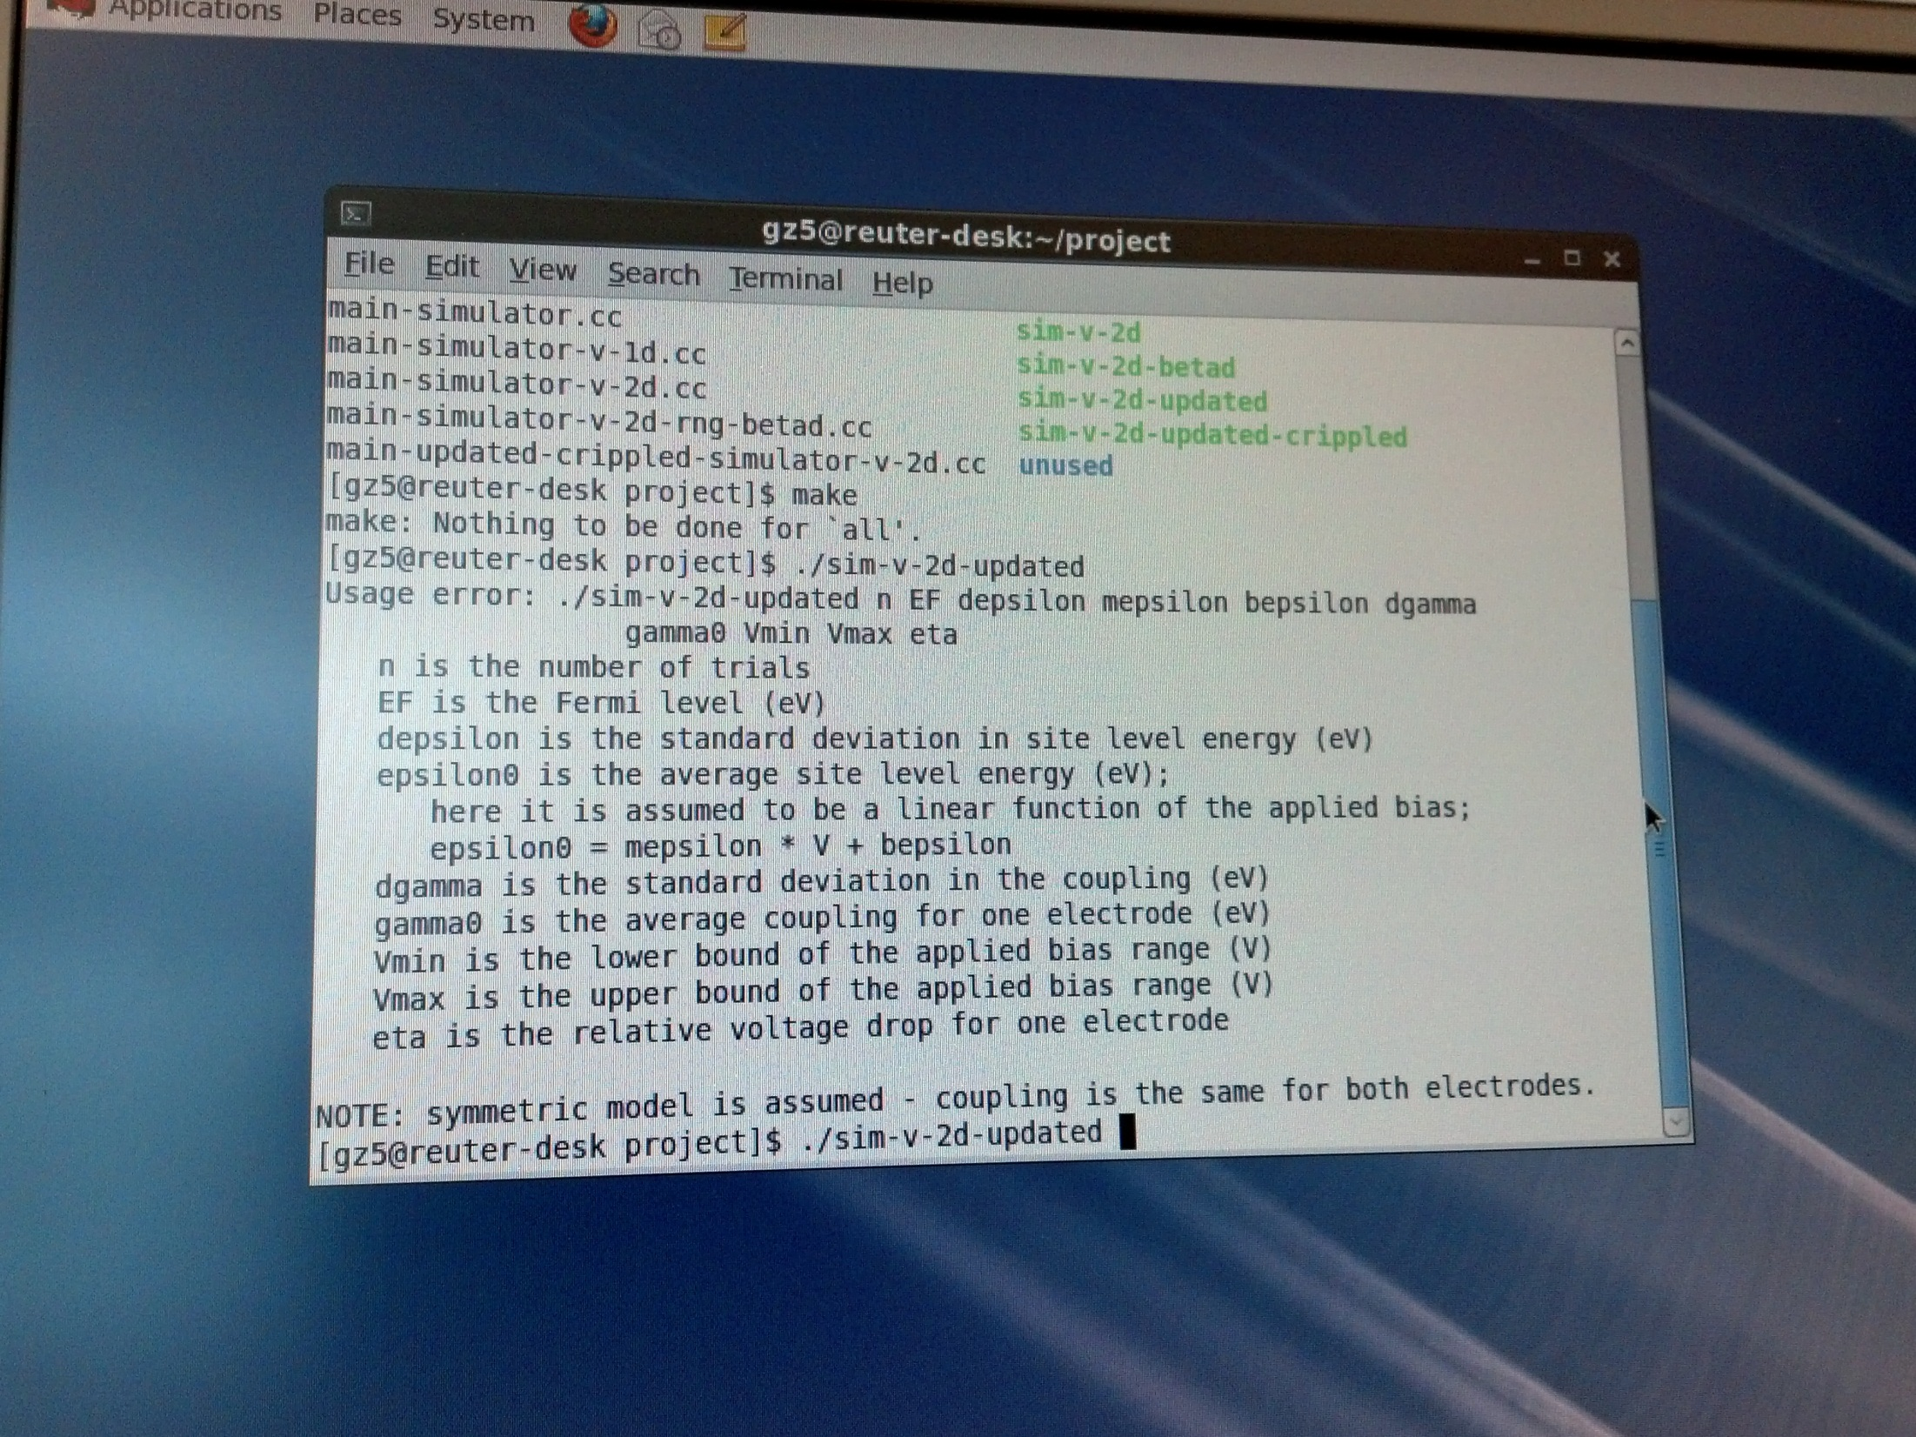

Slide 8
Final Simulator
Generates paired voltage and conductance data.
However, it assumes a linear relationship between epsilon (site energy) and voltage.
(assumed in order to simplify the integral in theory)

Slide 9
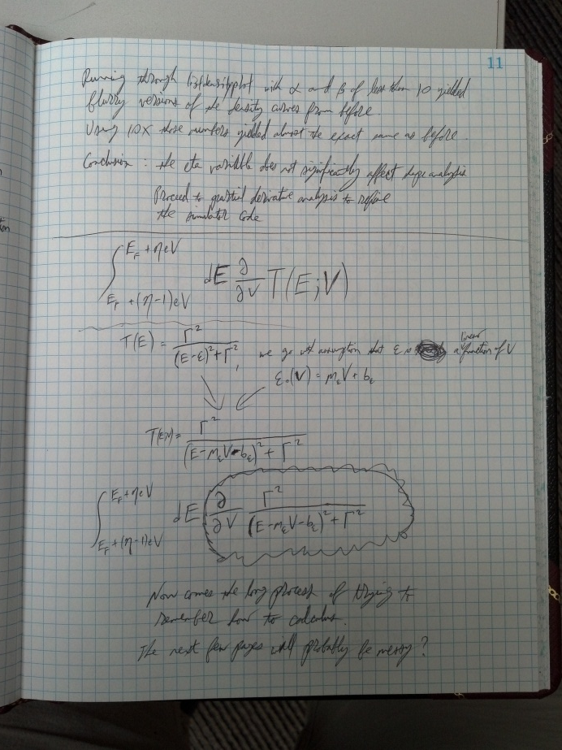
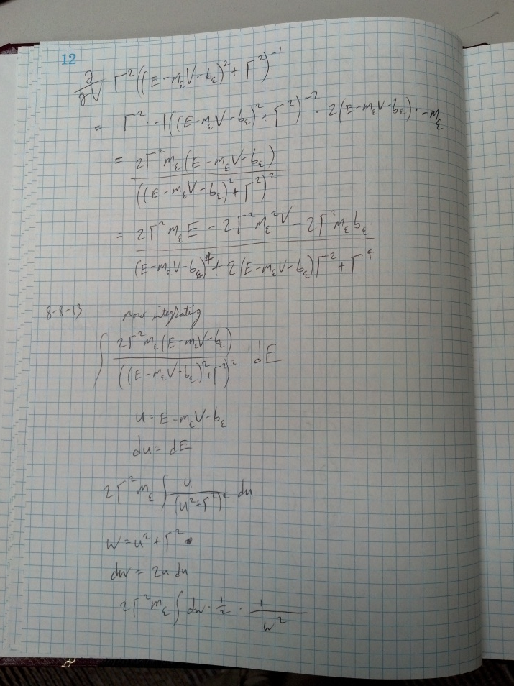
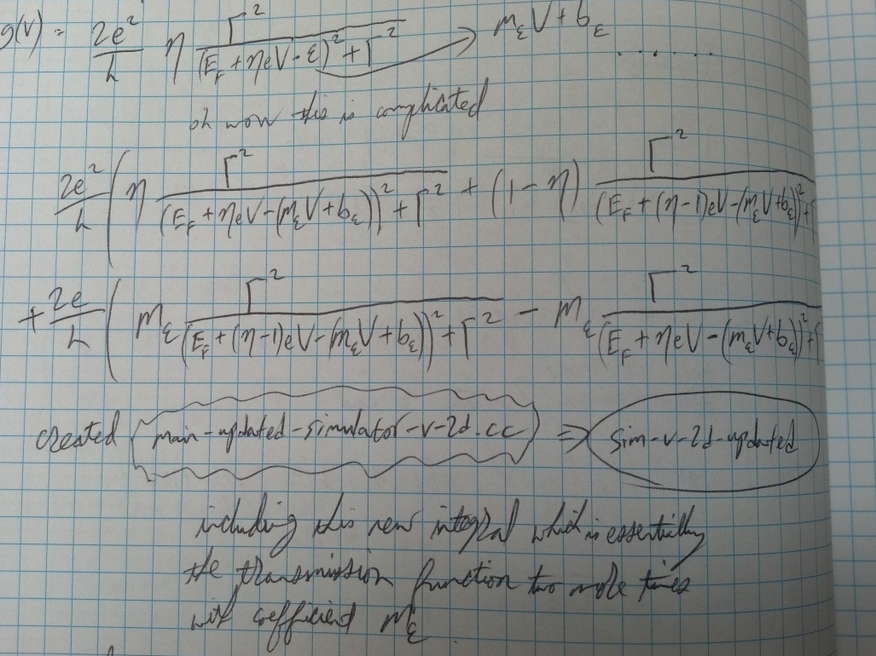
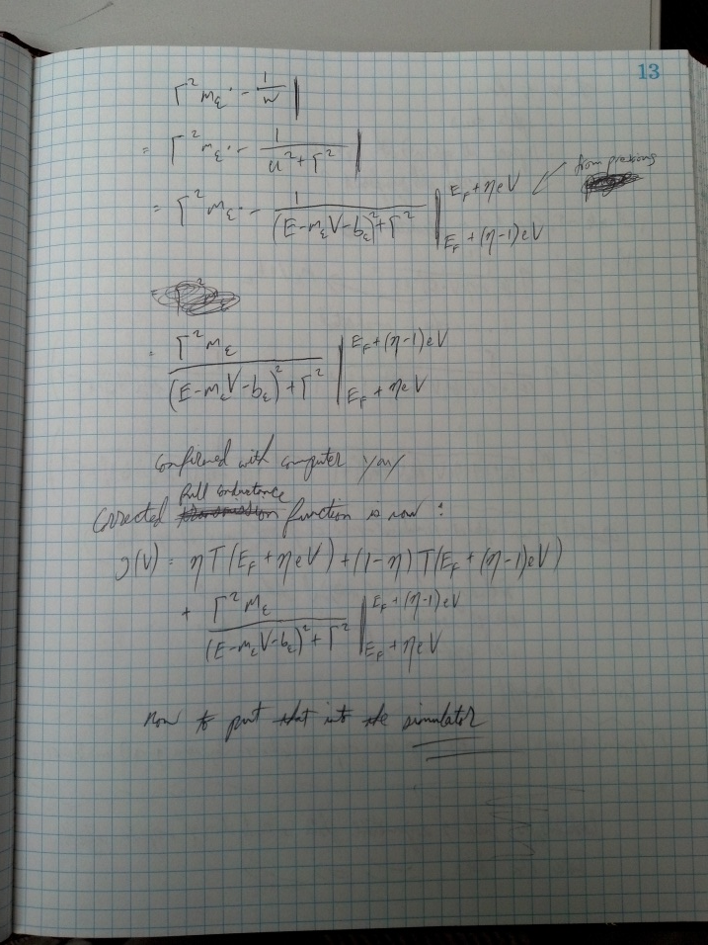

Slide 10
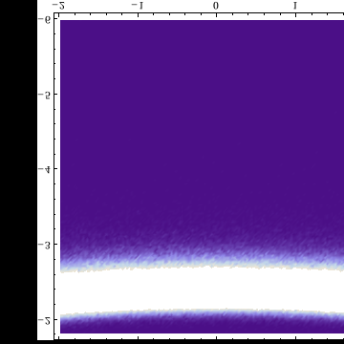
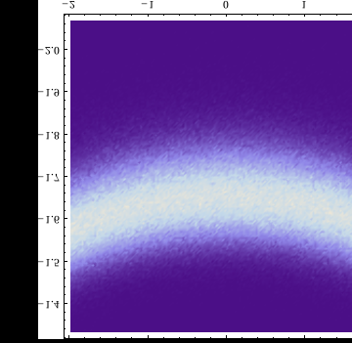
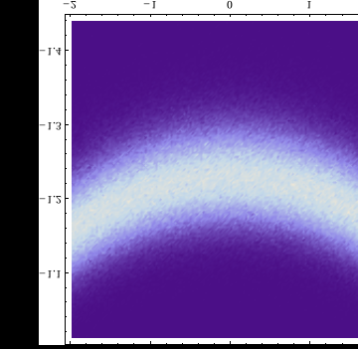
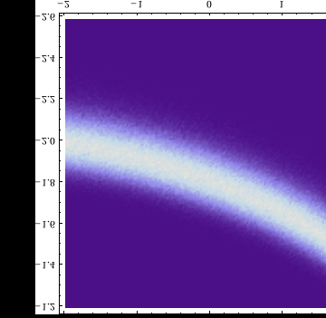
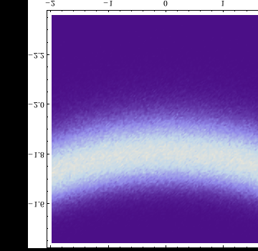
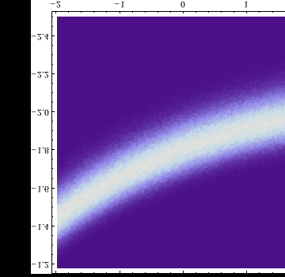
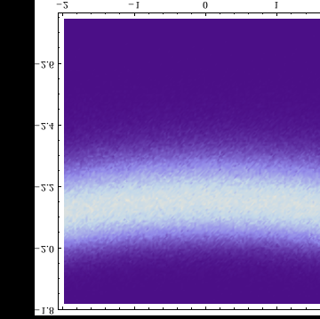
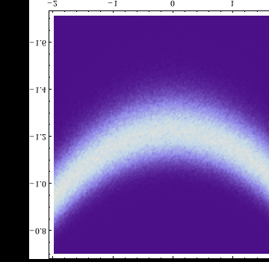
Yeah data
Gamma
Eta
Epsilon

Slide 11
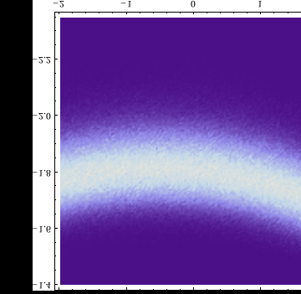
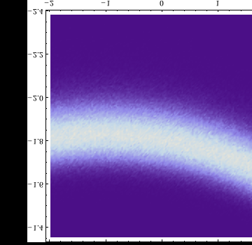
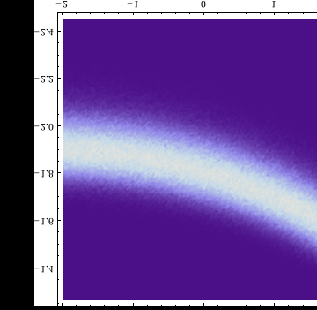
The Integral-Enhanced Model

